Slide 1
Components
COM, ActiveX,
JavaBeans
CORBA and SOAP

Slide 2

Brad Cox’s IC analogy
Software components should be like integrated circuits (ICs)
  Or plumbing components?
Why? What are our desiderata for software components?
Bertrand Meyer, in Object Oriented Software Construction:
modular (IC chips, disk drivers, are self-contained: packaged code)
a) compatible (chips or boards that plug in easily, simple interfaces)
b) reusable (same processor IC can serve various purposes)
c) extendible (IC technology can be improved: inheritance)
reliable (an IC works most of the time!)
a) correct (it does what it's supposed to, according to specification)
b) robust (it functions in abnormal conditions)
efficient (ICs are getting faster and faster!)
inexpensive (ICs prices are falling
portable (ease of transferring to different platforms)
timely (released when or before users want it)
What do you think: will any software paradigm answer all our wishes?

Slide 3
Definition of Software Components
Workshop on Component-Oriented Programming,
1996 European Conference on Object-Oriented Programming
“A software component is a unit of composition with contractually specified interfaces and explicit context dependencies only. A software component can be deployed independently and is subject to composition by third parties.”
Unit of composition – combine components to build systems
Binary units – black boxes, not source code
Contractually specified interfaces – mechanism for interface definition, such as Interface Definition Language
Independent production – separation of concerns
Deployed and composed by third parties – reusable units assembled like parts supplied by manufacturers

Slide 4
Why a component based approach?
Consider two ends of a spectrum:
  Comm. off the shelf < --- > Custom-made
  What advantages of COTS software could components offer to custom-made?
Advantages:
  Cost efficiency & flexibility
  Reuse, productivity
  Scalability
  Application of engineering techniques

Slide 5
Costs of components
It takes significant effort to create a software component that is effectively reusable. How so?
The component needs:
  to be fully documented;
  more thorough testing;
  robust input validity checking;
  to pass back useful error messages as appropriate;
  to be built with an awareness that it will be put to unforeseen uses
  a mechanism for compensating developers who invest the (substantial) effort implied above.

Slide 6
Distributed Component Technologies
The goal:
Integration of services for applications on various platforms
Interoperability: let disparate systems communicate
and share data seamlessly
Approaches:
- Microsoft: DDE, COM, OLE, OCX, DCOM and ActiveX
- Sun: JavaBeans, Enterprise JavaBeans, J2EE
- CORBA (Common Object Request Broker Architecture)
- Mozilla: XPCOM (Gecko functionality as components)
- SOAP (using XML)

Slide 7
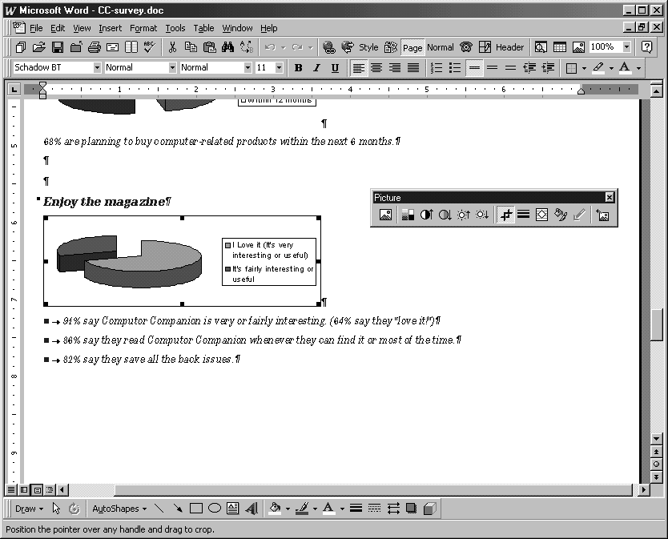
Example from Microsoft environment (80’s)
Excel-generated pie chart embedded in a Word document displayed in a PowerPoint presentation
Different applications need to share data or procedures

Slide 8

DDE (Dynamic Data Exchange)
A little history: starting with evolution of Microsoft approach:
  Windows gave PCs a more accessible computing environment
  Problem: lack of consistency between different programs
  What if spreadsheet and word processor need to share data?
Early solution was integrating suites into large programs:
  e.g., Microsoft Works – Pros and cons of suite approach?
Microsoft comes out with Dynamic Data Exchange (DDE), circa 1989
  Lets different Windows programs share data through links
  Suppose some spreadsheet data were linked into word processor
  When you changed data in spreadsheet, the new data would appear in word processor
  Limitation: you couldn’t update the data in the word processor; you had to invoke the spreadsheet to update the date there
  Worse, links were fragile and would break if you moved data files around in file system

Slide 9
OLE (circa 1991)
Object Linking and Embedding
  Linking is essentially DDE, using reference semantics
  Embedding lets users copy a snapshot of data into word processor and save it there
  Linking is cheaper when data files are large
  Embedding supports compound documents (“document-centric” computing)
A way for Windows to create documents containing objects from other programs.
  E.g. place a chart from Excel and a slide from PowerPoint into
  a Word document
  Components containers can be re-used by many applications
  But components do not make data independent of application programs, and OLE is a platform-specific solution.

Slide 10
OLE Technology (circa 1993)
A set of APIs to create and display a (compound) document
  Now possible to share code as well as data
Component Object Model (COM)
  COM protocols let components connect to origination program:
  E.g. word processor can tell spreadsheet, “the user just clicked on the spreadsheet, so start yourself up, look for data here, and let me know when you’re done.”
COM now includes OLE as part of a larger concept
  OLE becomes a set of standard COM interfaces
Embedded documents retain all their original properties
  If the user decides to edit the embedded data, Windows activates the originating application and loads the embedded document

Slide 11
OLE Extensions (OCX)
With Windows 95 came a new standard:
  OCX (OLE Custom eXtension component)
  A piece of code, smaller than application program, but with its own user interface
  Let users bundle OCX controls to form customized applications
  E.g., combine spell checker and synonym provider component to make a new program
  Is this beginning to sound like object-oriented programming?

Slide 12


ActiveX (circa 1996)
Microsoft retools OLE and COM as ActiveX
  ActiveX applies to a whole set of COM-based technologies
ActiveX control is Microsoft 's answer to the Java technology from
  An ActiveX control is roughly equivalent to a applet, but is known as an ActiveX control
Writing a program to run in the ActiveX environment creates a self-sufficient program that can run anywhere in ActiveX network
This component is known as an ActiveX control, and is often used to attach a program to a web page

Slide 13
ActiveX - implementation
An ActiveX control can be created using one of several languages
or development tools, including C++ and Visual Basic,
or with scripting tools such as VBScript.
Network OLE for rudimentary support of distributed applications
ActiveX controls originally were Windows only
  Other vendors later provided Mac and Unix/Linux support for ActiveX
Security issues: ActiveX controls have full file access (no sandbox)
  Can be signed for authentication
  Are signed controls secure enough?
  Here is what Microsoft says

Slide 14
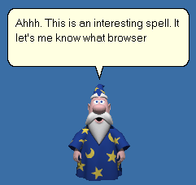
Example: MSAgent control
(Visual Basic)
Sub LoadMSAgent()
Resp = Window.Confirm "Use the MS Agent?"
If Resp Then
Window.Alert "Loading ActiveX Controls."
Document.WriteLn "<OBJECT ID='Agent' width=0 height=0"
Document.WriteLn "CLASSID='CLSID:F5BE8BD2-7DE6-11D0-91FE-00C04FD701A5'"
Document.WriteLn " CODEBASE='http://activex.microsoft.com/" & _
"controls/agent/msagent.exe#VERSION=1,5,1,0'>"
Document.WriteLn "<" & Chr(47) & "OBJECT>"
Document.WriteLn "<OBJECT ID='TruVoice' width=0 height=0"
Document.WriteLn " CLASSID='CLSID:B8F2846E-CE36-11D0-AC83-00C04FD97575'"
Document.WriteLn " CODEBASE='http://activex.microsoft.com/" & _
"controls/agent/cgram.exe#VERSION=1,5,0,0'>"
Document.WriteLn "<" & Chr(47) & "OBJECT>"
End If
End Sub

Slide 15
Communication Protocol Models
  Remote Procedure Call (RPC)
    Since 1980s, pioneered by Sun
    Tears of testing with various communication models
  Distributed extension of MS COM (DCOM)
    Lets COM talk to other platforms
    Complex configuration and complicated security model
  Remote Method Invocation (RMI)
    Communication between methods of Java classes
  Drawbacks of RPC/RMI approach?
    Platform-specific, procedural and low-level

Slide 16
The JavaBeans API
“A Java Bean is a reusable software component that can be manipulated visually in a builder tool.”
JavaBeans API makes it possible to write component software in Java
Components are self-contained, reusable software units that can be visually composed into composite components, applets, applications, and servlets using visual application builder tools.
JavaBean components are known as Beans.

Slide 17
Components and Software Architecture
Classes vs. components:
  class hierarchies + object collaboration = detailed design
  components + collaboration = architecture
Class vs. JavaBean:
  Class == a brick, a piece of wood, a nail
  Javabean = a wall element, a roof, a room
  Client application == a building
  An architecture does not concentrate on nails and bricks!

Slide 18
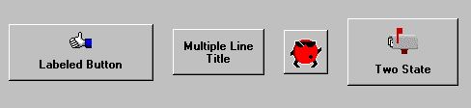
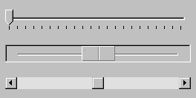
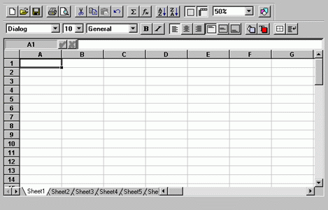
Sample Reusable Components
Button Beans
Slider Bean
An application constructed from Beans

Slide 19
JavaBeans made out of Java classes
Beans are classes that can be manipulated
in a visual builder tool and composed into apps.
Any Java class that adheres to certain conventions regarding property and event interface definitions can be a JavaBean.
Beans publish their attributes and behaviors through special method signature patterns that are recognized by beans-aware application construction tools.

Slide 20
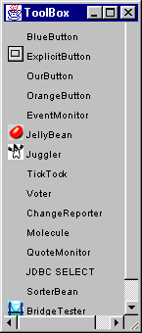
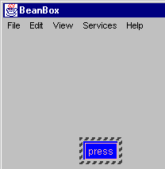
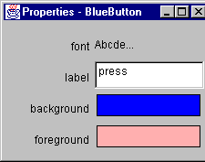

Slide 21
Builder Tools and Properties
Discover Bean’s Properties
Determine properties’ read/write attributes
Determine property types
Locate property editors
Display property sheet
Alter properties

Slide 22
Example Bean
A simple visual Bean:
import java.awt.*;
import java.io.Serializable;
public class SimpleBean extends Canvas implements Serializable {
private int simpleValue; //property of a SimpleBean
/** Default constructor sets inherited properties */
public SimpleBean() {
simpleValue=0;
setSize(60,40);
setBackground(Color.red);
}
/** getter and setter must follow conventions */
public int getSimpleValue() { return simpleValue; }
public void setSimpleValue(int value)
{ simpleValue = value; }
}

Slide 23
Java Bean
Features
  Properties: Beans can customize their attributes which determine their appearance and behavior
  Persistence (via serialization): can save and retrieve Beans data via external stores, possibly across a network
    java.io.serializable supports Read/Write state from/to stream
    store the values of instance variables
    store class version (hash for class name, fields, methods)
  Events: Beans can communicate and connect together
  Introspection (via reflection) builder tool can analyze how a Bean works
    Reflection API (java.lang.reflect)
    Supports run-time Class, Method, Constructor, Field info
  Customization: enables a developer use an app builder tool to customize appearance and behavior of Bean

Slide 24
Beans communicate via events
Message sent from one object to another.
Sender fires event, recipient (listener) handles the event
There may be many listeners.
Event source
Register listener
Fire event
Event listener
Event object

Slide 25
Bound Properties
When property changes, other objects may need to be notified and react.
When bound property changes, notification is sent to interested listeners.
Bean with bound property must maintain list of property listeners and fire PropertyChangeEvent objects

Slide 26
Persistence through Serialization
Beans use Java's object Serialization API to provide a great medium-weight solution for persistence.
The Beans.instantiate method is normally used by builder tools to recreate a Bean from a serialized Bean source
  I.e., cut and paste uses serialization
  to copy a Bean’s data
  Or Beans can connect or communicate
  with each other in an application
  or across the web

Slide 27
Java Reflection (introspection)
Java Reflection is a mechanism for inspecting the variables and methods of an unknown class at run time (or in a IDE such as BeanBox)
Reflection allows for
  finding methods, variables, constructors
  analyzing their types, parameters, results, modifiers
  changing variables
  calling methods or constructors
Reflection uses java.lang.Class and java.lang.reflect:
  java.lang.Class forName(String className)
  java.lang.reflect.Contructor[] getConstructors()
  java.lang.reflect.Field[] getFields()
  java.lang.reflect.Method[] getMethods()

Slide 28
Creating a new Bean
All beans must implement Serializable Interface
Compile the Bean
Create manifest file, made up of attribute/value pairs, e.g.:
Name: SimpleBean.class
Java-Bean: True
Create jar file (Java’s archive file format, zip compression):
  jar cfm SimpleBean.jar manifest.tmp SimpleBean.class
  create archive with archive file name, and manifest file
  jar also supports digital signatures, versioning, etc.
Load jar in BeanBox
Drop SimpleBean instance in BeanBox

Slide 29
Enterprise Java Beans (EJB)
A server-side component
  Contains the business logic of an application
  Application clients execute the business logic by invoking the enterprise bean's methods
Why are EJBs attractive?
Frees application developer from dealing with system level aspects of an application
Allows bean developer to focus solely on
the logic of the application.

Slide 30
Middleware approach
Middleware
  General-purpose software that manages communication between distributed components (modules, classes, JavaBeans)
  Thus it sits in the middle, between distributed components, the glue between components
Reuse benefits?
  The developer doesn’t have to write code to communicate across processes or processors
  Middleware “broker” handles bindings between components, so that components can be reused in other contexts without changing its code

Slide 31
CORBA
Common Object Request Broker Architecture
  Created by Object Management Group (consortium of 700+ companies)
  Defines how distributed, heterogeneous objects can interoperate
Location Transparency
  Client has no idea where object resides, where it is local or remote
Objects
  Gives object-oriented benefits at a higher level
  E.g. encapsulation – must access through IDL, polymorphism, inheritance of interfaces, exception handling
Portable
  across platforms, languages, networks
Standard

Slide 32
CORBA architecture
Interface Definition Language (IDL)
  Similar to interfaces in Java or C++ abstract classes
  Defines protocol to be used between devices
  Allows “wrappers” for legacy systems
Application Programming Interface (API)
  Ensures consistency for clients and CORBA objects (in theory)
Object Request Broker (ORB)
  Middleware establishing client/server relationship
  Allows transparent invocation of methods
  Intercepts calls, and deals with them
    Find an object that can implement the request, pass it the parameters, invoke its method, and return the results
  Client remains ignorant of how calls are dealt with

Slide 33
CORBA architecture
Client
Object Implementation
Dyn.
Inter-
face
IDL
Stub
ORB
Interface
IDL
Skeleton
Object
Adapter
Object Services: naming, events, life cycle, persistence, transactions, concurrency, relationships, externalization, object licensing, properties, object query
ORB
OS Kernel
OS Kernel
Network

Slide 34
IDL Interface for Quoter
interface Stock {
double price ();
readonly attribute string symbol;
readonly attribute string full_name;
};
interface Stock_Factory {
Stock get_stock (in string stock_symbol)
raises (Invalid_Stock_Symbol);
};
What feature does this look like from another language? Why?

Slide 35
Client - Manage ORB in Stock Quoter
In Client.cpp:
int main (int argc, char* argv[])
{
try {
//First initialize the ORB...
CORBA::ORB_var orb = CORBA::ORB_init(argc,argv,""/*ORB name*/);
//Get reference to desired object and call methods to this object
orb->destroy(); //Done, free orb resources
}
catch (CORBA::Exception &ex) {
std::cerr << "CORBA exception raised!" << std::endl;
}
return 0;
}
Client.cpp

Slide 36
Client - Get Quoter object reference
In Client.cpp:
#include "QuoterC.h”
//Get reference to desired object
CORBA::Object_var factory_object =
orb->string_to_object(argv[1]);
//Call methods through this object
Quoter::Stock_Factory_var factory = //Get a factory
Quoter::Stock_Factory::_narrow(factory_object.in());
for (int i = 2; i != argc; ++i) {
try { //Get the stock object
Quoter::Stock_var stock = factory->get_stock(argv[i]);
}
}
Client.cpp

Slide 37
Implement method get_stock()
Stock_
Factory_i
In Stock_factory_i.cpp:
// Return Object Reference
Quoter::Stock_ptr Quoter_Stock_Factory_i::get_stock
(const char *symbol) throw (Quoter::Invalid_Stock_Symbol)
{ if (strcmp (symbol, "RHAT") == 0)
{ return this->rhat_._this(); }
else if (strcmp (symbol, "MSFT") == 0)
{ return this->msft_._this(); }
throw Quoter::Invalid_Stock_Symbol();
}

Slide 38
Implementing Stock Interface
In Stock_i.cpp:
class Quoter_Stock_i : public POA_Quoter::Stock
{
public:
Quoter_Stock_i(const char *symbol, const char*full_name, CORBA::Double price);
private:
std::string symbol_;
std::string full_name_;
CORBA::Double price_;
};
Stock_i

Slide 39
Implement server
Server.cpp
int main (int argc, char* argv[])
{ try
{ // First initialize the ORB
CORBA::ORB_var orb = CORBA::ORB_init(argc,argv,""/*ORB name */);
CORBA::Object_var poa_object =
orb->resolve_initial_references ("RootPOA");
PortableServer::POA_var poa =
PortableServer::POA::_narrow (poa_object.in ());
PortableServer::POAManager_var poa_manager =
poa->the_POAManager ();
poa_manager->activate ();
//The application code goes here!
//Clean up the server objects (wait until destruction is done)
poa->destroy(1, 1); orb->destroy();
}
catch (CORBA::Exception &ex)
{ std::cerr << "CORBA exception raised!" << std::endl; }
return 0;
}

Slide 40
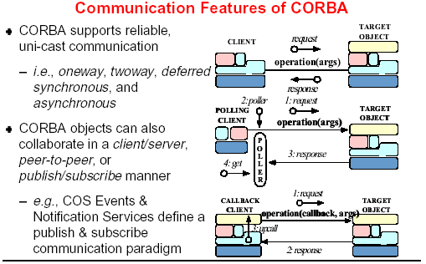

Slide 41
Communication protocol models
Common Object Request Broker Architecture (CORBA)
  CORBA2 adopted in 1994
  A specification of services helpful to build distributed applications
Remote Method Invocation (RMI)
  Used for communication between components across a network (for example, in Java)
Simple Object Access Protocol (SOAP)
  A protocol specification for invoking methods on different servers, services, components and objects

Slide 42
Web services with SOAP
  Emerging standards support web services, all in XML:
  UDDI (Universal Description, Discovery and Integration)
  - describes a way to publish & discover information
  (directory)
  WSDL (Web Service Definition Language)
  - describes services as a set of endpoints operating on messages
  SOAP (Simple Object Access Protocol)
  - defines the overall message structure of web service request

Slide 43
SOAP uses Internet Protocols
What is SOAP?
  An open wire protocol specification that defines a uniform
  way to access services, objects and servers in various platform
    Works with existing Internet infrastructure
    Talks to web server via XML text rather than several ports
  HTTP as the underlying communication protocol
  - Encapsulate messages between objects in HTTP
  XML as the data serialization format.
  - Client and server exchange data in SOAP-XML messages

Slide 44
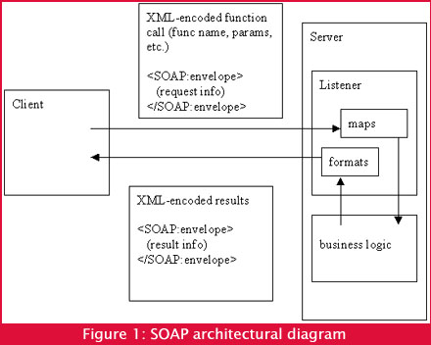
[from What the heck is SOAP anyway by David Platt ]

Slide 45
SOAP specification
  SOAP messages describe information in XML:
    Consists of a SOAP envelope and encoding rules
    Envelope defines name spaces used in the definition
    of the enclosed data structures
    Encoding rules describe how to serialize data and a
    convention for making remote procedure calls (RPC)

Slide 46
Transmission data format
CORBA | SOAP
1. CORBA transmits data using binary encoding. 2. It does not encode any meta-information, assuming that both the sender and the receiver have full knowledge of the message context. Pros and cons? Performance? N-tier architectures? | 1. SOAP transmits data as messages in XML text. 2. SOAP messages encode meta-information describing messages. Pros and cons? Performance? Debugging? Convergence of implementations?

Slide 47
Interoperability
CORBA | SOAP
1. CORBA 1.0 had problem with being unable to build a system of interoperable ORBs implemented by different vendors. 2. CORBA 2.0 resolves the problem by defining a single wire-format to guarantee that two separately developed CORBA implementations work together. | Being based on HTTP protocol and XML format, interoperability is easy between different SOAP-enabled computer systems.

Slide 48
Object identity and lifetime
CORBA | SOAP
1. A particular instance of a CORBA object is identified by an object reference. 2. CORBA is used for transparent communication between application objects. | 1. SOAP doesn’t mandate any object identity other than an URL endpoint. 2. Lifetime of SOAP objects on the server becomes an issue if the server is maintaining state. 3. Server needs to timeout SOAP objects to reclaim their resources.

Slide 49
Security
CORBA | SOAP
1. The CORBA Security Service provides a security architecture that can support a variety of security policies to meet different needs. 2. The Service specifies the authentication, authorization, and encrypting of messages. | 1. SOAP bypasses firewalls by going through the web server which requests method invocation based on SOAP messages. 2. HTTPS (secure) to prevent snooping; client and server can verify each other's identity. 3. A standard called XML Key Management Specification (XKMS) is under development to provide finer grain security that is necessary to authenticate particular users of specific Web services.

Slide 50
Ease of use
CORBA | SOAP
Being based on a distribution of clients and servers makes CORBA complex when getting things started. | 1. HTTP and XML make for easy implementation and debugging. 2. Text-based representation of information allows for easy deciphering of method calls and return results.

Slide 51
Tools using SOAP for Web Services
  Microsoft SOAP Toolkit 2.0
    Provides necessary components for both client-side
    and server-side, and other operations for Web Services
    Available on web site: http://msdn.microsoft.com/downloads/default.asp?
    URL=/code/sample.asp?url=/msdn-files/027/001/580/msdncompositedoc.xml
  IBM Apache SOAP
    Based on the IBM SOAP4J implementation.
    Available on web site: http://xml.apache.org/soap/

